Slide 1
Lecture 6
Sidra Khatoon

Slide 2
Developing an ER Diagram
Consider a case study of collage administration. College is divided into several schools: business, arts and sciences, education, and applied sciences. Each school is administered by a dean who is a professor. Each professor can be the dean of only one school, and a professor is not required to be the dean of any school. Therefore, a 1:1 relationship exists between PROFESSOR and SCHOOL. Note that the cardinality can be expressed by writing (1,1) next to the entity PROFESSOR and (0,1) next to the entity SCHOOL.
Each school comprises several departments. For example, the school of business has an accounting department, a management/marketing department, an economics/finance department, and a computer information systems department. Note again the cardinality rules: The smallest number of departments operated by a school is one, and the large number of departments is indeterminate (N). On the other hand, each department belongs to only a single school; thus, the cardinality is expressed by (1,1). That is, the minimum number of schools to which a department belongs is one, as is the maximum number.

Slide 3
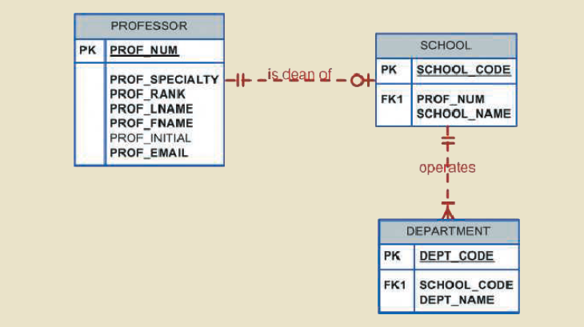

Slide 4
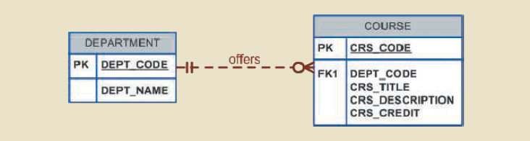
Developing an ER Diagram
Each department may offer courses. For example, the management/marketing department offers courses such as Introduction to Management, Principles of Marketing, and Production Management. For example, if College had some departments that were classified as “research only,” they would not offer courses; therefore, the COURSE entity would be optional to the DEPARTMENT entity.

Slide 5
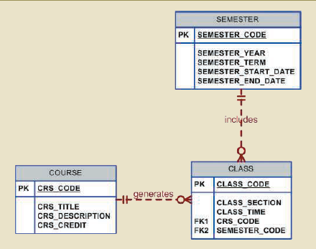
Developing an ER Diagram
A department may offer several sections (classes) of the same database course. Each of those classes is taught by a professor at a given time in a given place. In short, a 1:M relationship exists between COURSE and CLASS. Additionally, each class is offered during a given semester. SEMESTER defines the year and the term that the class will be offered.

Slide 6
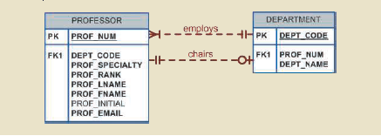
Developing an ER Diagram
Each department should have one or more professors assigned to it. One and only one of those professors chairs the department, and no professor is required to accept the chair position. Therefore, DEPARTMENT is optional to PROFESSOR in the “chairs” relationship.

Slide 7
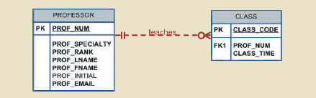
Developing an ER Diagram
Each professor may teach up to four classes; each class is a section of a course. A professor may also be on a research contract and teach no classes at all.

Slide 8

Developing an ER Diagram
A student may enroll in several classes but take each class only once during any given enrollment period. Each student may enroll in up to six classes, and each class may have up to 35 students, thus creating an M:N relationship between STUDENT and CLASS.
A CLASS can initially exist at the start of the enrollment period even though no students have enrolled in it, STUDENT is optional to CLASS in the M:N relationship.

Slide 9
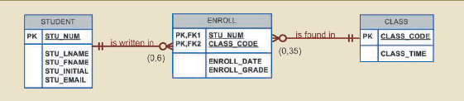
Developing an ER Diagram
This M:N relationship must be divided into two 1:M relationships through the use of the ENROLL entity.
Note that the optional symbol Is shown next to ENROLL. If a class exists but has no students enrolled in it, that class does not occur in the ENROLL table
The ENROLL entity is weak: it is existence-dependent, and its (composite) PK is composed of the PKs of the STUDENT and CLASS entities.

Slide 10
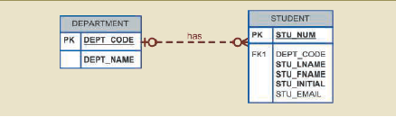
Developing an ER Diagram
Each department has many students whose major is offered by that department. However, each student has only a single major and is therefore associated with a single department.

Slide 11
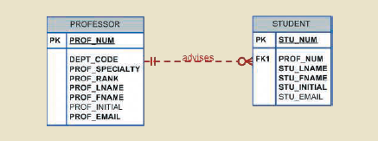
Developing an ER Diagram
Each student has an advisor in his or her department; each advisor counsels several students. An advisor is also a professor, but not all professors advise students. An advisor is also a professor, but not all professors advise students. Therefore, STUDENT is optional to PROFESSOR in the “PROFESSOR advises STUDENT” relationship.

Slide 12
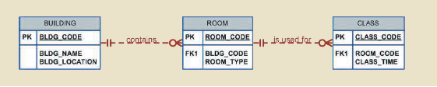
Developing an ER Diagram
The CLASS entity contains a ROOM_CODE attribute. It is clear that ROOM_CODE is an FK to another entity. Clearly, because a class is taught in a room, it is reasonable to assume that the ROOM_CODE in CLASS is the FK to an entity named ROOM.

Slide 13
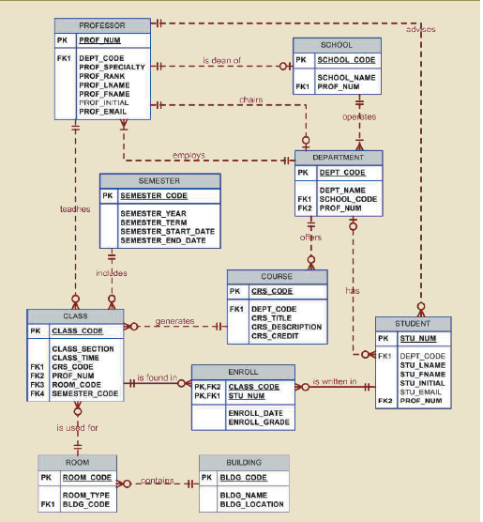
ER Diagram with Chen Notation

Slide 14
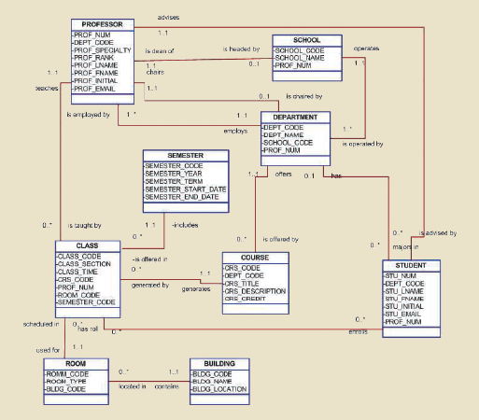
The Conceptual UML Class Diagram

